Slide 1
Car store analysis
Prepared by
Mohamed abdelwahab Farid Ashmawy[Data cleaning SQL]
Mohamed Ayman Abdelhakam [EDA python]
Safaa Elsayed Dawood[Data visualization]
Aya Mahmoud Fouad [Tableau Dashboard & data visualization]

Slide 2
About the project
This is the Car sales data set which include information about different cars . This data set is being taken from the Analytixlabs for the purpose of prediction In this we have to see two things First, we have seen which feature has more impact on car sales and carry out result of this Secondly, we have to train the classifier and to predict car sales and check the accuracy of the prediction.

Slide 3
When analyzing data for the car business, key insights often revolve around understanding customer preferences, market trends, operational efficiency, and profitability. Here are some of the most valuable insights you can derive from automotive data:
1. *Customer Preferences & Buying Behavior*
- *Vehicle Type Preference*: Analyze trends in preferences for SUVs, sedans, trucks, electric vehicles (EVs), and hybrids. Understanding which models or segments are gaining popularity can guide inventory and marketing strategies.
- *Price Sensitivity*: Identify how price changes impact demand. Segment customers by budget to target pricing strategies more effectively.
2. *Market Trends*
- Brand Loyalty & Switching*: Investigating customer retention rates, brand loyalty, and reasons for switching brands (e.g., reliability, cost of ownership, technology) can help improve long-term customer engagement.

Slide 4
3. *Technological Advancements* - *Connected Car Features*: The rise of in-car technology (e.g., infotainment systems, autonomous driving, connected car services) is shaping customer preferences. Tracking which features are most desired helps refine product offerings and marketing strategies. - *Autonomous & Semi-Autonomous Driving*: Analyzing the readiness of the market for autonomous features, consumer trust in these technologies, and regulatory developments is crucial for future planning. 4. *Competitive Benchmarking* - *Competitor Analysis*: Compare performance with competitors in terms of sales, customer satisfaction, and market share. Understanding competitor pricing, product offerings, and marketing strategies helps identify opportunities and threats. - *New Entrants (EV-focused companies) *: Companies like Tesla have disrupted the market. Keeping track of new entrants, especially in the EV sector, and how they are shaping customer preferences is key to staying competitive.

Slide 5
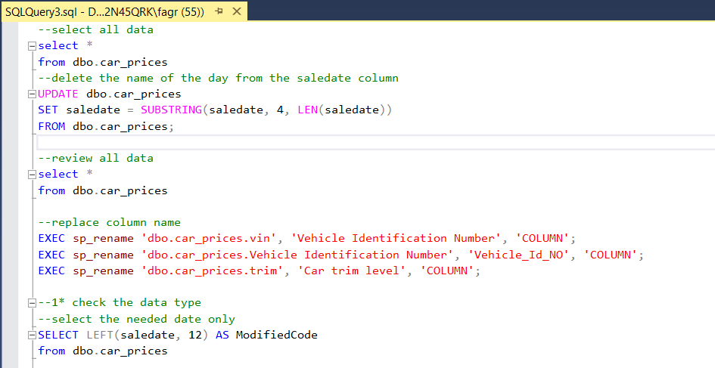
Cleaning data in SQL

Slide 6
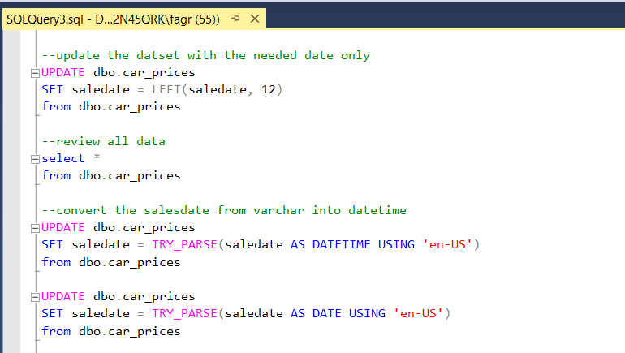

Slide 7
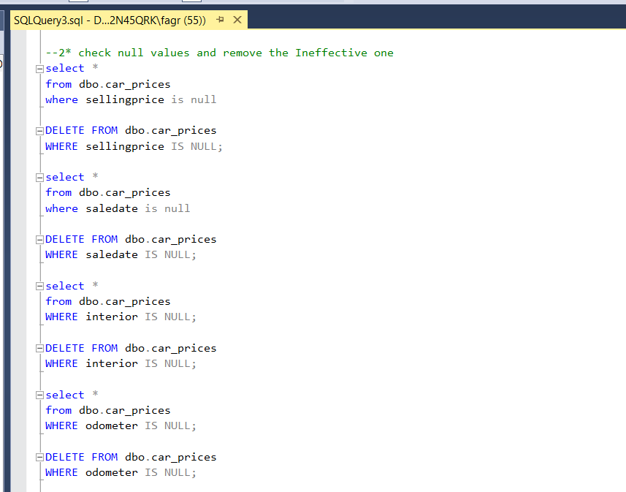

Slide 8
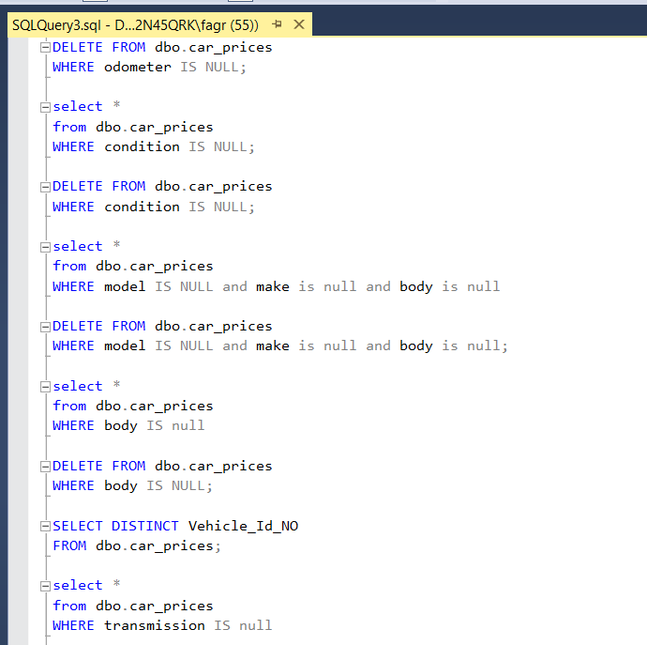

Slide 9
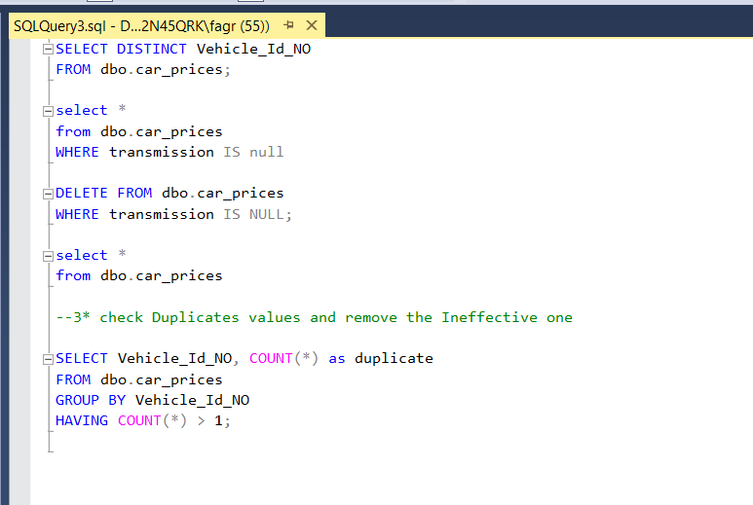

Slide 10

EDA Analysis with python

Slide 11

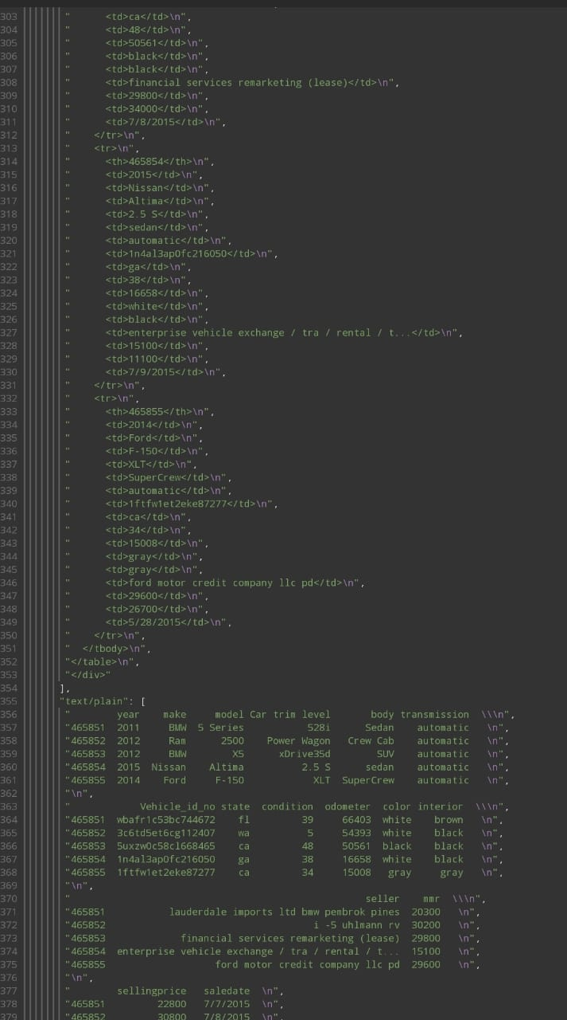

Slide 12


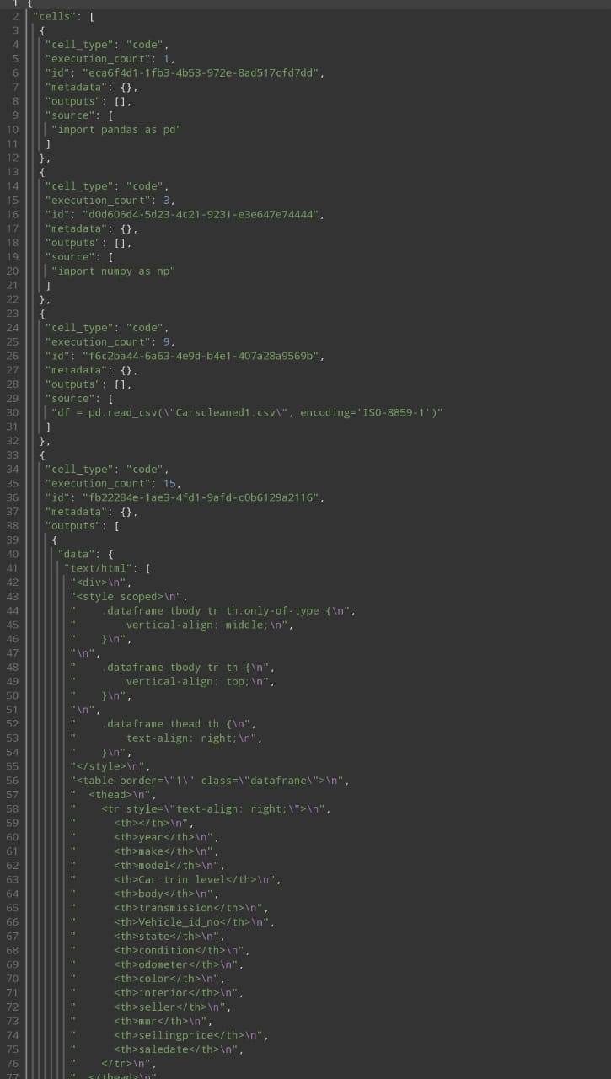

Slide 13




Slide 14


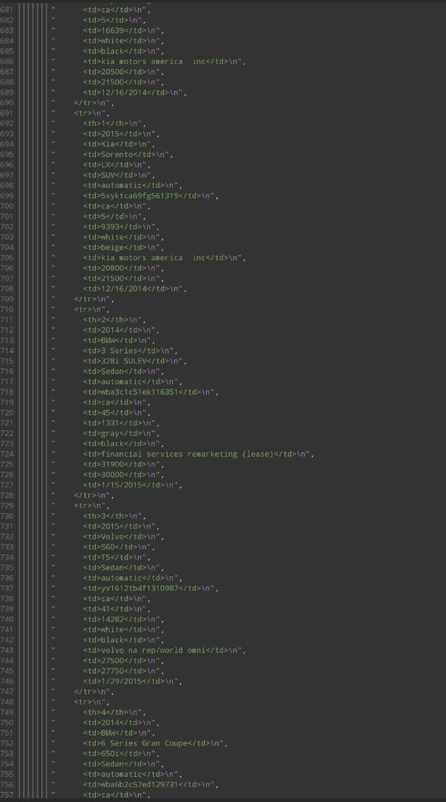

Slide 15

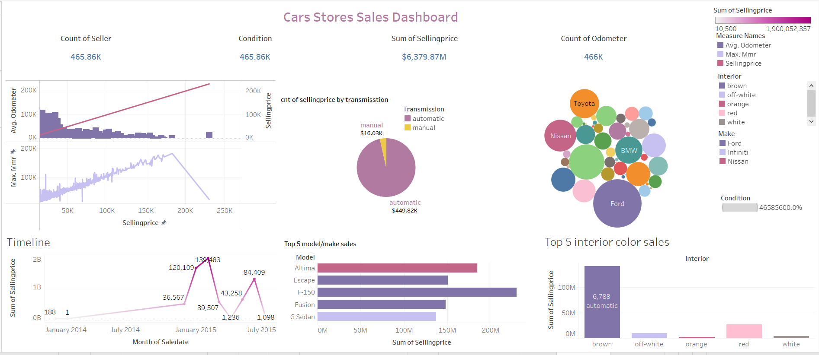
Dashboard

Slide 16
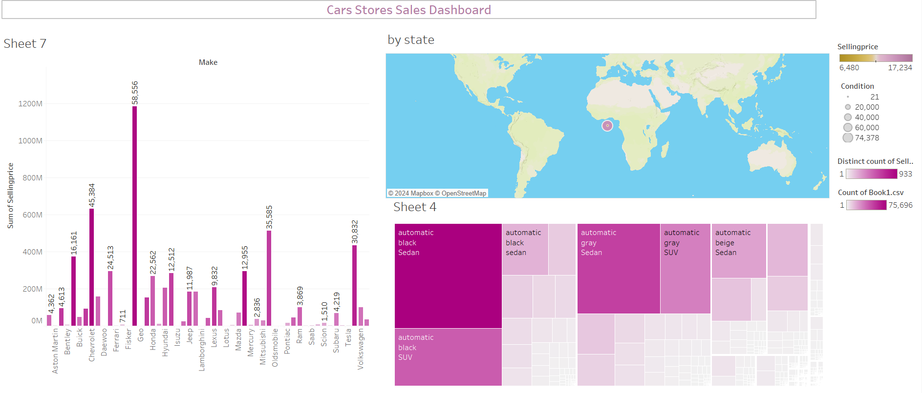

Slide 17


